Slide 1
KTH in brief

Slide 2
Welcome to KTH
As a world-class institute
of technology, KTH is contributing to social development –
now and in the future.
Peter Gudmundson,
President, KTH

Slide 3
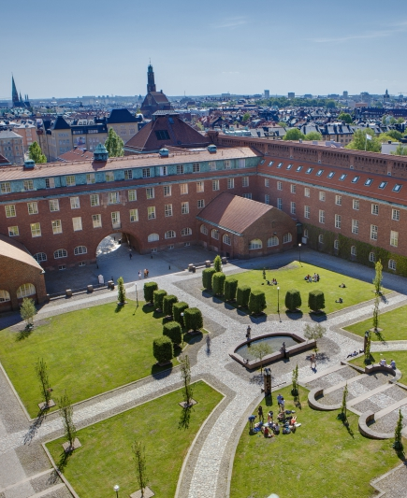
Sweden's leading university of technology
  Sweden's oldest and largest university of technology
  More than 12,000 full-time students
  More than 1,900 PhD Students
  Over 5,100 employees
  Five campuses in the Stockholm region
  Ranked as the 126th best university of technology in
  the world by THE
Notes:
Founded in 1827, KTH Campus moved into the premises at Valhallavägen in 1917.
Sweden's King, Carl XVI Gustaf of Sweden, is the university's patron.
Sweden's largest institute of technology, with a total of 14,000 students (including exchange students, fee-paying students and PhD students)
Platform organisation for better synchronisation between subjects and better use of research funds. KTH's platforms comprise ICT, energy, life science technology, materials and transport.
Five campuses located in central Stockholm, Haninge, Södertälje, Flemingsberg and Kista. Each campus has its own distinctive character and facilitates in-depth studies, profiling and collaboration with the industry that the students are gaining qualifications for.
Ranked as no. 126 of the world's universities, and as the seventh best institute of technology in Europe, according to THS (2013)

Slide 4

KTH's history
2010 SciLifeLabs is established as a collaboration between four universities with the support of the Swedish Government
2001 AlbaNova, the Stockholm Center for Physics, Astronomy and Biotechnology is launched
1999 KTH is established in Kista
1970 Hannes Alfvén, Professor at KTH, is awarded the Nobel Prize in Physics
1954 Sweden's first nuclear reactor is launched 30 meters below ground at KTH Campus
Sweden’s first official televisiono broadcast is
sent from KTH
1917 moves to new premises on Valhallavägen
1877 The name Kungliga Tekniska högskolan is
established
1827 The Institute of Technology is launched
Notes:
KTH's origins lie in the teaching that began in 1827 at the Institute of Technology in Stockholm, the centre for vocational engineering studies at the time. The education provided here was intended to be "popular and practical". Industrialisation was experiencing rapid growth and demands were placed on a school that could meet the growing demand for engineers.
"Science and art" became a hallmark of the school and which is still going strong to this day. The motto was originally meant to imply the art of engineering.
As a step toward a more scientific orientation, the name Kungliga Tekniska Högskolan (the Royal Institute of Technology) was introduced in 1877. Gradually, the institute began conducting research and students were required to produce a thesis. However, the final academic recognition was only achieved following the introduction of a PhD in Technology in 1927.
By then, KTH had been housed for a decade in the grand premises on Norra Djurgården, which still house much of the current operations.
The facilities now have a geographical distribution across the entire county and total some 250,000 m².
KTH has grown steadily, and this process began early on. With the incorporation of Bergsskolan i Falun [the School of Mining in Falun] in 1867, the school gained four established areas of study: Mining Science, Mechanical Engineering, Chemical Technology & Engineering, and Civil Engineering. Thereafter, new subject areas have constantly been added – Building Architecture (1877), Electrical Engineering (1901), Naval Architecture (1912), Surveying and Engineering Physics (1932), Computer Science (1983), and Industrial Economics (1990).
More information about KTH's history can be found at http://www.kth.se/om/fakta/historik

Slide 5
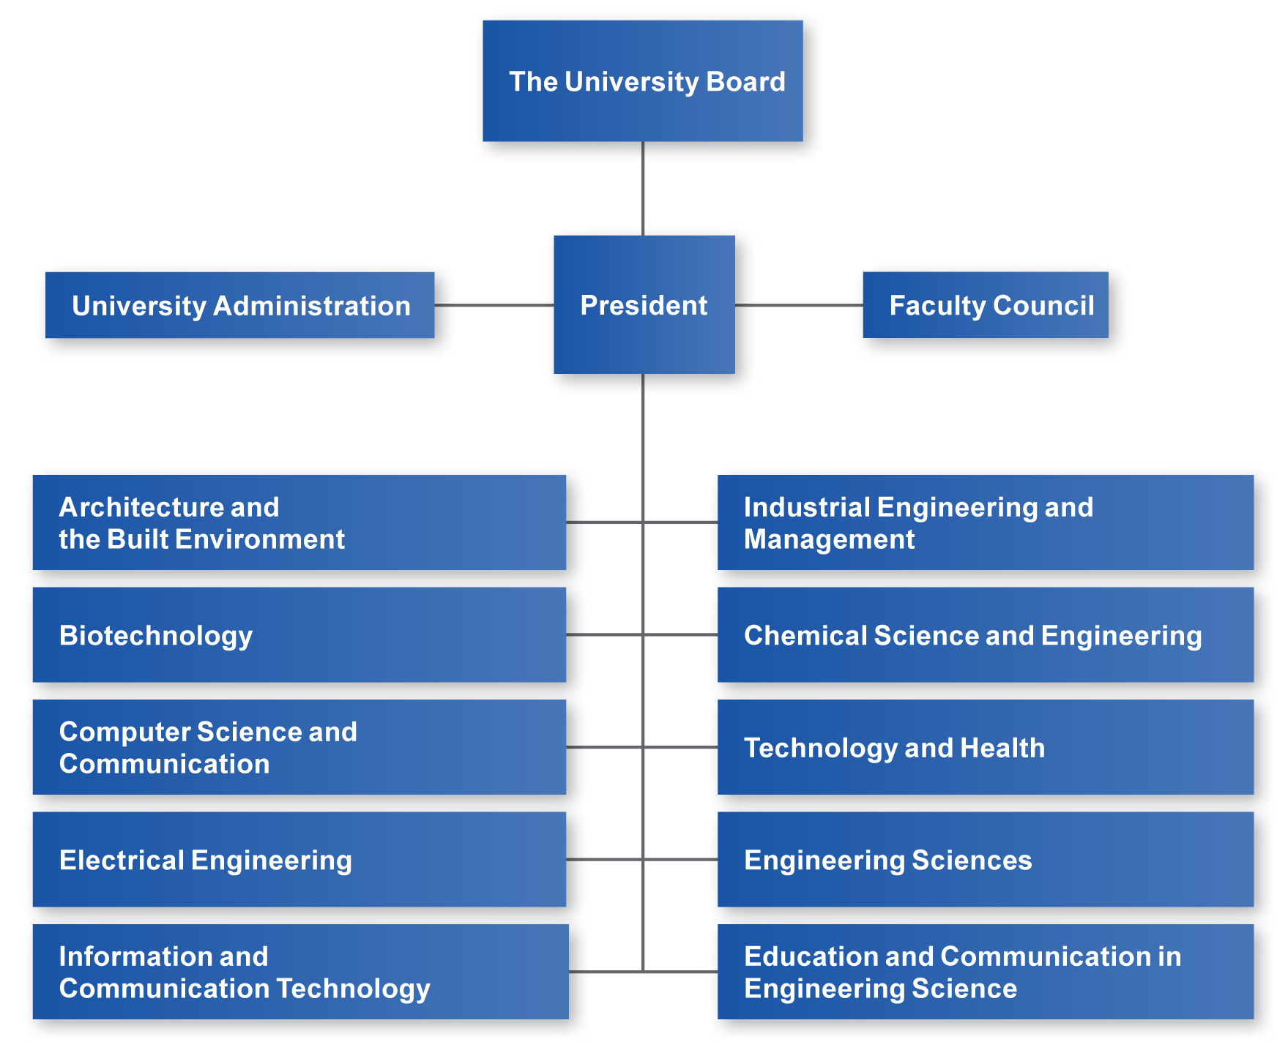
KTH's organisation
2014
Notes:
The University Board is the overarching body that governs the university's operations.
The President is the agency head and, under the University Board, has overall responsibility for KTH's operations. The President is appointed by the government for a maximum of six years upon the recommendation of KTH's University Board. The Deputy President is appointed by KTH's University Board and is the President's substitute. Vice-Presidents are appointed by the President for special assignments.
The Faculty Council represents the entire faculty and is an advisory body to the President. The Council has overall responsibility for issues relating to the quality of education, research and community collaboration.
The Faculty Council consists of the following:
Seven teachers who hold a teaching position at KTH and who have scholarly or artistic expertise, i.e., they have completed a PhD degree or equivalent, one of whom is the Chairperson.
Three external members who are not employed at KTH.
The students have the right to be represented by three members.
Three representatives of the employee organisations have attendance and consultation rights at the Faculty Council meetings.
The Employment Committee has three main functions: preparation and decisions regarding promotion matters, preparation and decisions regarding matters surrounding the recruitment of instructors as well as the preparation of KTH's work with quality development and follow-up concerning teaching positions. The students have the right to be represented by three members.
The Committee has three main functions: The overarching design of programme offerings at the Bachelor's, Master's and Doctoral levels, preparation of KTH's work with quality development and follow-up regarding education, and the preparation of KTH-wide development of regulations and guidelines concerning education. The students have the right to be represented by three members.
In order to facilitate and strengthen the faculty's access to information and influence on processes and decisions, there is also a Faculty Advisory Council at KTH. The main function of this Advisory Council is to support and communicate questions of particular significance to KTH's faculty.
The University Administration manages administration and services for the entire university.
Education and research are managed within the framework of the KTH Schools. The activities of KTH's Competence Centres are primarily conducted in new fields of research, often in collaboration with society and industry. KTH's Centres are always connected at the organisational level with one of the KTH Schools.

Slide 6


A top-ranked institution
Times Higher Education (THE)
30th in Engineering and Technology
52nd best university in Europe
The world's 126th best university
QS World University Ranking
Ranked 16 in the world in Electrical Engineering
Ranked 21 in the world in Architecture and Built Environment
Ranked 25 in the world in Mechanical Engineering
Figures for 2014 and 2015
Notes:
Ranking 2014 and 2015:
QS World University Rankings:
The world, total: 110, engineering och technology: 30
Civil & Structural Engineering: 37, Materials Science: 39
Topp 51-100: Chemical Engineering, Computer Science & Info Systems, Matematik, Physics & Astronomy, Statistics & Operational Research,
Times Higher Education:
The world, total: 126
Shanghai Jiao Tong:
The world, total: 201-300, Engineering: 76-100, Physics: 151-200, Computer Science: 101-150
http://www.qs.com/
http://www.timeshighereducation.co.uk/
http://www.shanghairanking.com/

Slide 7
Research-based operations
Total Revenue SEK 4,243 (4,038) million
Figures for 2014 (2013)

Slide 8
KTH's funding
Total Revenue SEK 4,243 (4,038) million
Figures for 2014 (2013)

Slide 9

Research for Sweden's competitiveness
  Broad research, from science to community planning
  Research involves more than 3,000 colleagues
    More than 600 people belong to the Faculty
    Approximately 300 Professors, of which
    47 are women
    More than 1,900 PhD Students
  More than 60 Adjunct Professors
Figures for 2014
Notes:
Education and research at KTH Royal Institute of Technology cover a wide area – from science to all the branches of engineering as well as architecture, industrial economics, and community planning.
Doctoral studies (PhD) at KTH are conducted within doctoral programmes. The programmes entail a coherent structure which can contain one or more doctoral studies subject areas.
KTH's Competence Centres conduct research primarily in new fields and often in collaboration with society and industry. A Centre can be associated with a specific department but can conduct research independently, in most cases with a specific board with representatives from industry and society. It can also be an autonomous unit directly subordinate to the President. The majority of the Centres maintain close connections with industry, and a number of them are also collaborative units between KTH and other universities.
Those counted as doctoral students are those studying at a pace of at least 50 per cent of full-time.

Slide 10
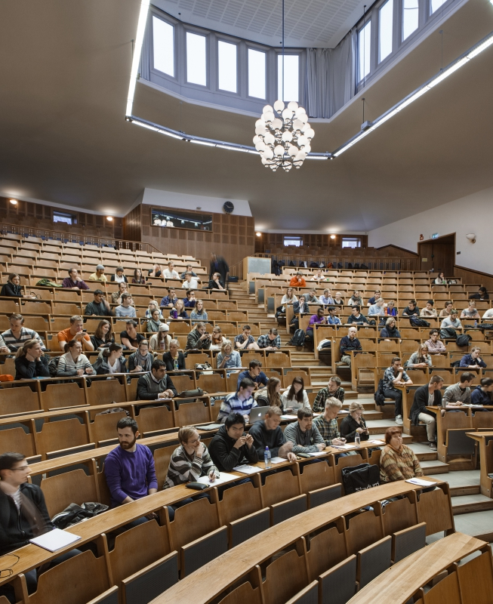
High quality programmes
  KTH educates students to become Masters of Architecture Masters and Bachelors of Science in Engineering, teachers, Licentiates and PhDs
  More than 12,000 full-time students, of which 32 per cent are women
  KTH's programmes have strong links to research and industry
Notes:
Many of KTH's departments have their own industrial councils. Through these councils, companies can influence the content of the study programmes and ensure that they maintain high quality with close connections to the needs and expertise of industry.
Five campuses located in central Stockholm, Haninge, Södertälje, Flemingsberg and Kista. Each campus has its own distinctive character and facilitates in-depth studies, profiling and collaboration with the industry that the students are gaining qualifications for.
Project work, assignments and degree projects are often produced at or in collaboration with companies.

Slide 11
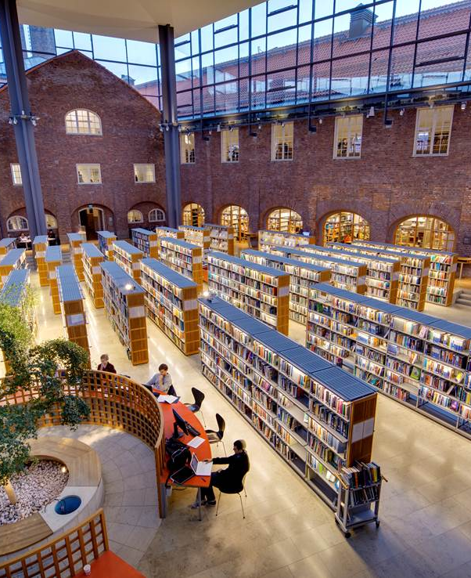
An international university
  Students and personnel from more than
  100 countries
  English-language programmes
  Double degree programmes
  Degree projects abroad
  Exchange studies
  International alliances,
  e.g., CLUSTER and INSPIRE
Notes:
KTH is an international university with students from all around the world. The University collaborates with Europe's leading technological universities and with prestigious universities around the world. There is a long tradition of conducting and participating in international exchanges and projects in the framework of programmes such as Lifelong learning/Erasmus, Erasmus Mundus, Marie Curie, MFS (Minor Field Studies) and Linnaeus-Palme, among others. Comprehensive work is also pursued in developing nations.
KTH has cooperation agreements with Europe's leading technological universities and with prestigious universities around the world. In 2013 started a total of 618 (509) students studying abroad. Of them studied 51 percent at a university outside Europe. During the year began 1 058 (1 372) exchange students study
at KTH. Most students came from universities in Germany, France and Spain.
The Master's degree in Architecture and Civil Engineering is offered in English. KTH offers a large number of Master's programmes in English, with both Swedish and foreign applicants. This initiative is in keeping with KTH's objective to increase the research-based component of undergraduate work, and to participate in a global educational context.
KTH manages and participates in a great number of international projects. Many are funded by one of the EU's programmes for education and research, like Lifelong Learning, Erasmus Mundus, Marie Curie and Tempus, among others. Other projects are funded by national programmes, such as the Sida programmes Linnaeus-Palme and MFS, for example.
KTH has elected to focus its networking activities on four prioritised regions. These four regions are India, China, South East Asia and Brazil. The prioritisations are primarily intended to form the basis for the long-term work of recruiting non-European Master's students.

Slide 12
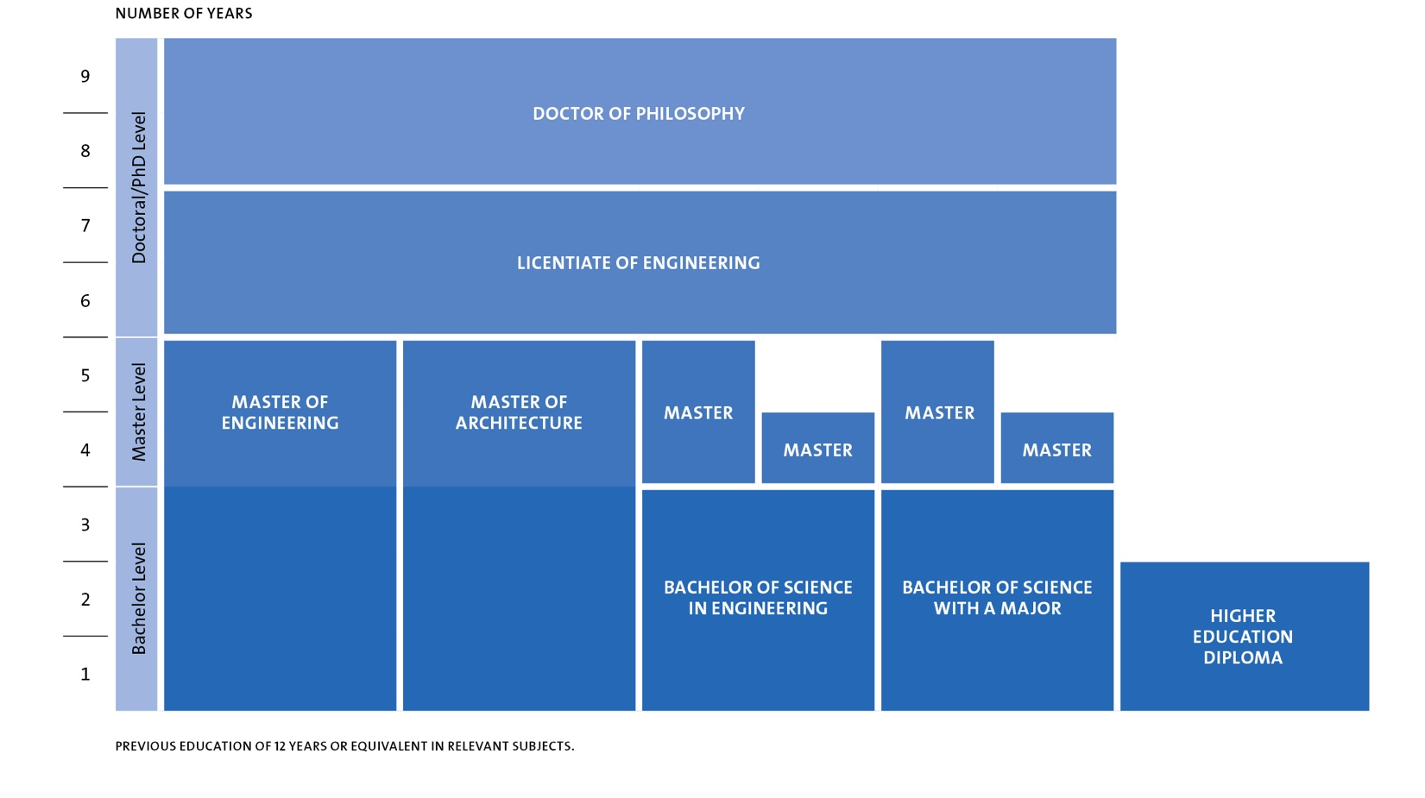
Degrees adapted to the Bologna Process
Notes:
Studies at the higher education level are divided into three cycles:
1. Bachelor level (first cycle) – the first three years
2. Master level (second cycle) – one or two years following the first level
3. Doctoral/PhD level (third cycle) – three or four years following the second level
In order to advance to the next level, students must have completed degrees from the previous level(s). Bachelor's level courses are usually taken in years 1-3, and Master's level courses are usually taken in years 4-5 in the Civil Engineering programme as well as in the Master's programmes.

Slide 13
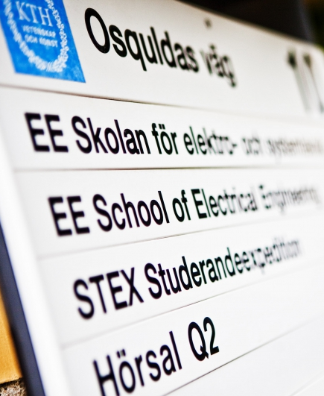
A wide range of programmes
Programmes in
  Architecture and the Built Environment
  Computer Science and Electrical Engineering
  Energy and Sustainable Development
  Industrial Management and Innovation
  Information and Communication Technology
  Life Science Technology
  Teacher Education
  Mechanical Engineering
  Materials Science
  Engineering Physics and Mathematics

Slide 14
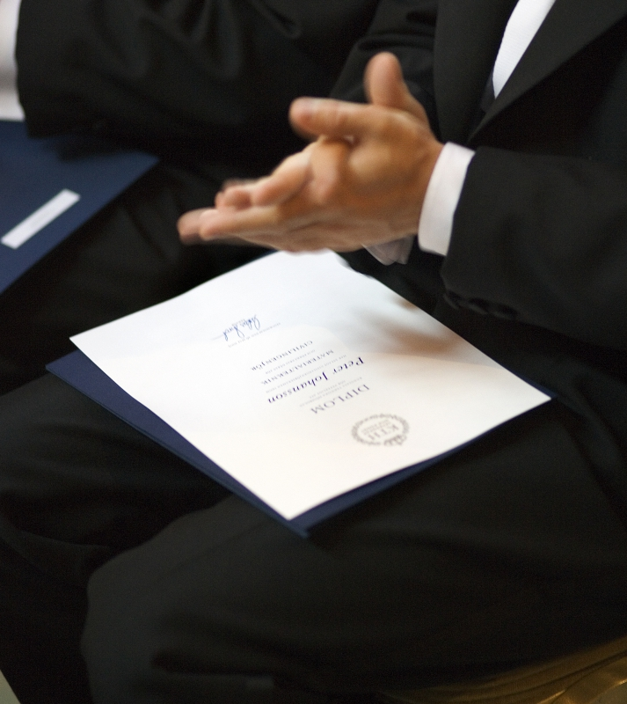
Over 3,000 degrees per year
  100 architects, of which
  49 per cent are women
  1,141 Masters of Science in Engineering, of which
  30 per cent are women
  353 Bachelors of Science in Engineering, of which
  27 per cent are women
  1,244 Master's degrees,
  of which 30 per cent are women
  279 PhD degrees, of which 25 per cent are women
Figures for 2014
Notes:
Figures for the 2013 Annual report.

Slide 15
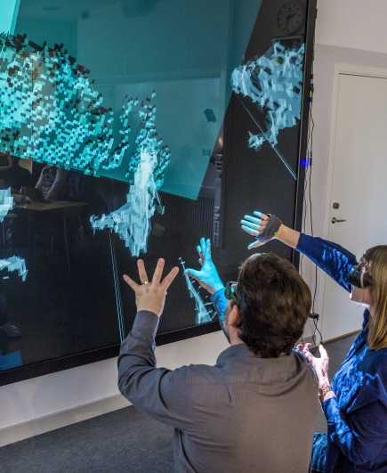
World-class career opportunities
  67 per cent get their dream job with a degree from KTH
  52 per cent receive job offers before they graduate
  87 per cent get a job within six months after graduation
  93 per cent get a job within one year
Figures from the most recent Career Report (2014)
Notes:
KTH performs a comprehensive career survey of alumni every second year. The purpose is to examine the work situation of graduates, their career development and how they view their previous education.
(Source: Career Report 2011)

Slide 16

An attractive university for doctoral students
1,900 doctoral students
30 per cent are women
279 PhD degrees
26 per cent are women
Figures for 2014
Notes:
Doctoral studies (PhD) at KTH are conducted within doctoral programmes. The programmes entail a coherent structure in which a programme can contain one or more doctoral studies subject areas.
In 2011, 350 students were newly enrolled in doctoral studies.
Those counted as doctoral students are those studying at a pace of at least 50 per cent of full-time.

Slide 17

KTH conducts research with the rest of the world
  International research cooperation
    59% of publications are international joint publications
  Leading partner within two of the European Institute of Innovation and Technology's (EIT) Knowledge and Innovation Communities (KIC).
    InnoEnergy
    ICTLabs
    Part of SciLifeLab, a national centre together with Karolinska Institutet (KI), Stockholm University (SU) and Uppsala University (UU)
Figures for 2014
Notes:
KTH's Competence centres conduct research primarily in new fields and often in collaboration with society and industry. A centre can be associated with a specific department but can conduct research independently, in most cases with a specific board with representatives from industry and society, or it can be an autonomous unit directly subordinate to the President The majority of the centres collaborate very closely with industry and in most cases, they are also collaborative units between KTH and other universities.
SciLifeLab was established in 2010 with the support of the Government as a collaboration between four universities: KTH, Karolinska Institutet, Uppsala University and Stockholm University. In total, there are more than 100 research groups associated with SciLifeLab which combine advanced methods and equipment with a broad base of expertise within engineering-driven molecular biosciences and traditional medicine. Researchers from all over Sweden can use both the technology and the expertise available at SciLifeLab.
KTH also belongs to two out of three consortia within the prestigious EU collaboration, European Institute of Technology (EIT), whose mission is to make Europe a global leader in innovation. KTH leads the information and communication technology consortium (EIT ICT Labs) and the energy consortium (KIC InnoEnergy), both of which were selected through tough competition. The consortia include research institutes, large engineering companies and several of Europe's leading technical universities.

Slide 18
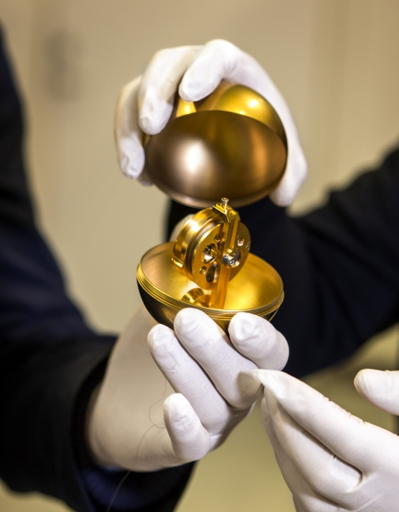
World-class research
Energy
Information Technology
Biotechnology/
Life Sciences
Materials
Transport
Notes:
Prioritised research fields at KTH

Slide 19
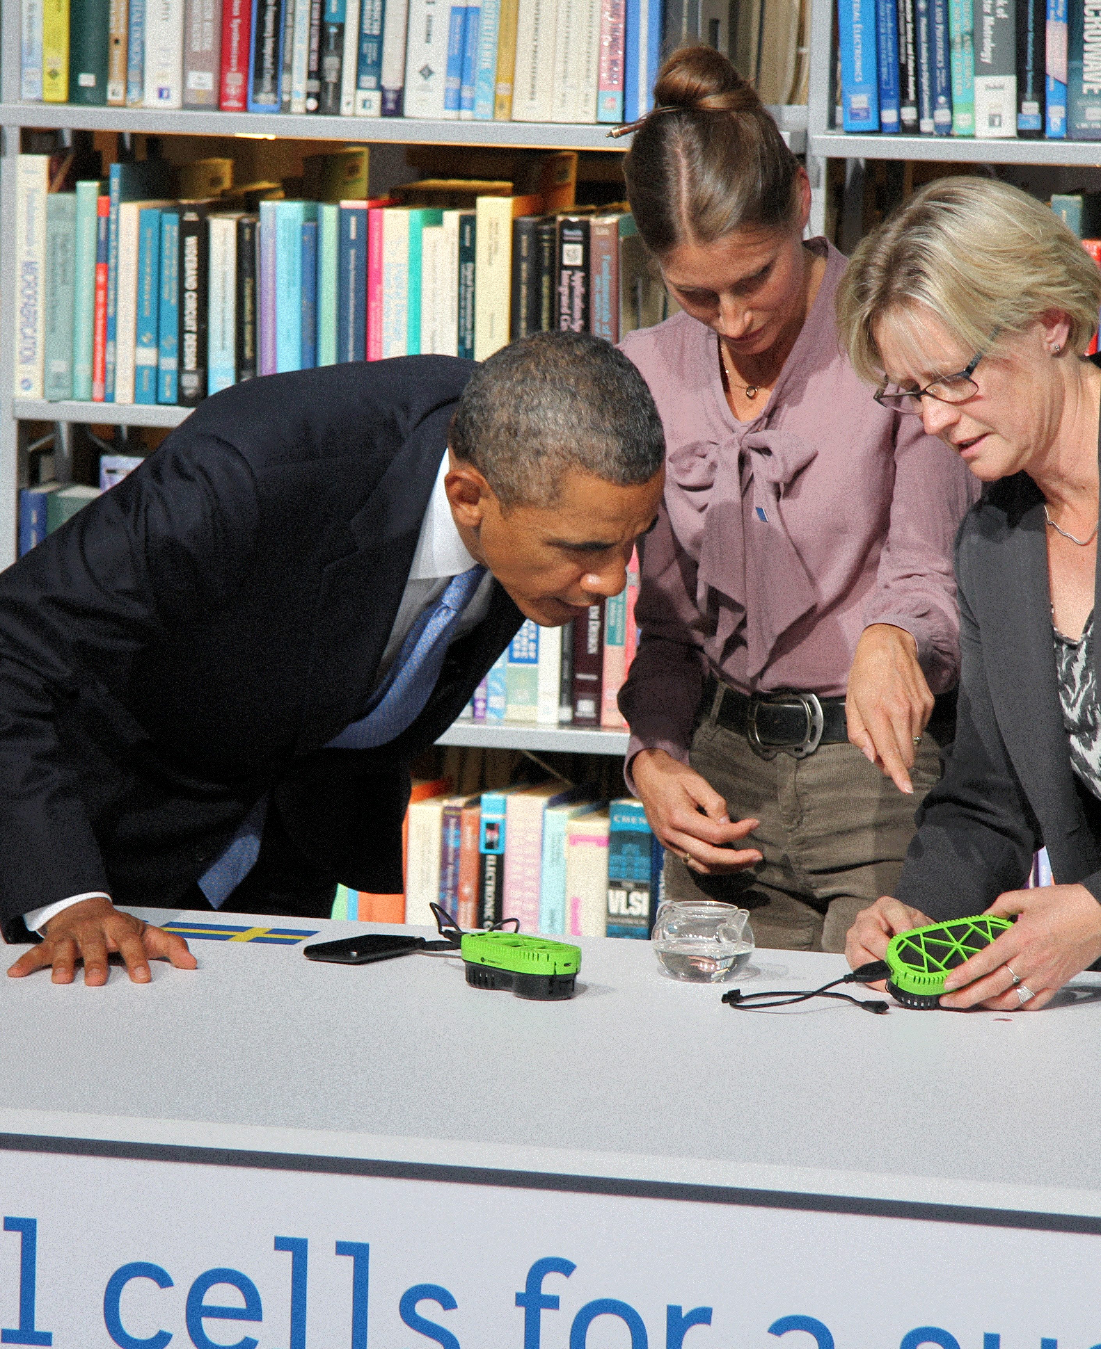
The President of the USA visited KTH in 2013
In the autumn of 2013, Barack Obama visited KTH together with the former Prime Minister, Fredrik Reinfeldt
The focus of the visit was innovations within the fields of environmental engineering and renewable energy
KTH researchers Rakel Wreland Lindström and Carina
Lagergren show President Obama how a fuel cell charger works.

Slide 20
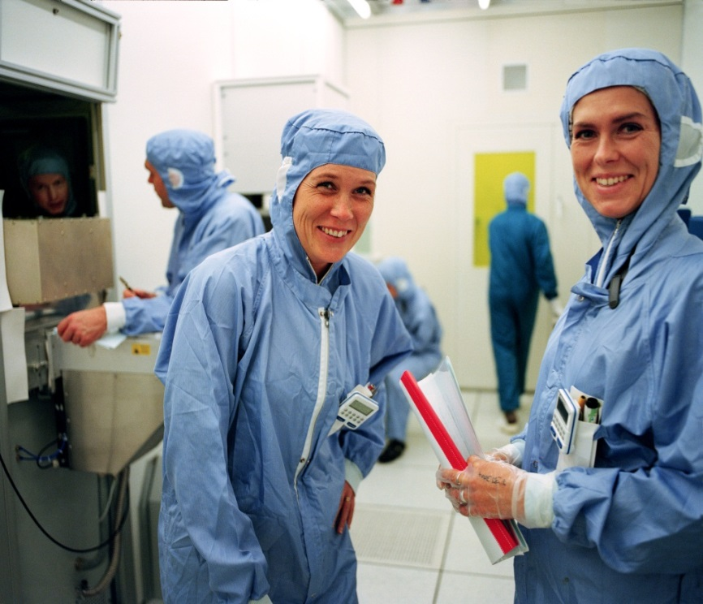
KTH research platforms
Energy
Technologies and systems supporting sustainable global energy systems.
Information and Communication
Technology
Focuses on fields such as microelectronics, nanotechnology, photonics and wireless sensor
networks.
Notes:
Energy
Energy research and education at KTH aims to expand the frontiers of knowledge in pursuit of technologies and systems supporting sustainable global energy systems. This ranges from innovative smart electric grids to more efficient electric vehicle batteries and commercially viable alternative energy systems.
Information and Communication Technology
ICT has emerged as a key driver of global economic growth, creating new applications in health care, intelligent infrastructure, smart homes and sustainable energy. The ICT Research Platform focuses on fields such as microelectronics, nanotechnology, photonics and wireless sensor networks.
Materials
Materials science investigates the relationship between the atomic or molecular structure of materials and their macroscopic properties. Research within the Materials Platform spans from chemistry, fibre and polymer technology to biotechnology, mechanics and process technology.

Slide 21
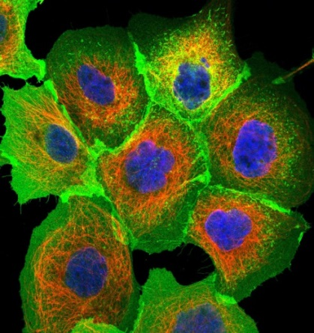
KTH Research platforms cont.
Materials
Spans from chemistry, fibre and polymer
technology to biotechnology, mechanics and
process technology.
Medical and Biomedical Technology
Recognised international research leader in
the borderland between technology, natural
sciences and medicine, including e g the
mapping of all human proteins.
Transport
Various disciplines, from vehicle technology
and infrastructure to policy formulation and
evaluation.
Notes:
Medical and Biomedical Technology
KTH is a recognised international research leader in the borderland between technology, natural sciences and medicine. This includes the mapping of all human proteins, development of technology for large-scale genetic analysis, and cancer diagnosis and treatment.
Transport
Transportation research at KTH integrates various disciplines, from vehicle technology and infrastructure to policy formulation and evaluation. This includes not only traditional fields such as vehicle and railway engineering, flight technology and civil engineering, but also emerging themes such as alternative fuels, intelligent transportation systems and the politics and economics of future transport systems.

Slide 22


Ideas and companies by KTH students
Spotify
Rapidly expanding on-demand music
streaming service
More than 10 million users
Tobii
Eye tracking technology
Market-leader to industrial partners
Winner of Bully Award 2011
Notes:
Spotify, the rapidly expanding on-demand music streaming service with over 10 million users, is the brainchild of kth graduates. “There has been plenty of hype about Spotify,” KTH alum and Spotify developer Andrew Mathews once said, “and now a great deal of the challenge is to prove that we can deliver.” With a recent nationwide launch on the U.S. market, the company is now meeting that challenge.
Tobii is the world’s leading vendor of eye tracking and eye control: a technology that makes it possible for computers to know exactly where users are looking. Our technology is widely used in various research fields and as a means to control computers. The idea of eye tracking came from a research project at the Royal Institute of Technology in Stockholm and Tobii was founded in 2001.
Bully Award: winner 2011 The Bully Award is honoring Europe’s leading technology, media and telecommunications (TMT) companies. Tobii is a Longhorns winner awarding post Series A firms; growth stage companies.

Slide 23
Core values at KTH
KTH’s core values are based on democracy, the equal value of human beings, human rights and freedom and free and open discussion. Equality between men and women and the dissociation from all forms of discrimination are both an issue of quality and a natural part of KTH’s core values. Equality and diversity among employees and students also represent important resources for KTH.

Slide 24
Opennes and equal opportunities: from legislation to policies and actions
Swedish legislation which lays ground for operation of public universities:
Higher Education Act
Higher Education Ordinance
Work environment law
Discrimination Law
Parental leave law
Discrimination Ombudsman

Slide 25
Opennes and equal opportunities: from legislation to policies and actions
Work environment at KTH:
Work environment policy
Systematic work on enabling functioning work environment
Work Environmental Plan
Occupational healthcare and preventive healthcare
Stress treatment
Employee survey

Slide 26
Opennes and equal opportunities: from legislation to policies and actions
Continuous work against discrimination:
Discrimination act
Contact persons for help and support
Introductory course for new employees
University regulation on handling cases of discrimination, harrassment, sexual harrassment and unappropriate treatment
Discrimination ombudsman

Slide 27
Opennes and equal opportunities: from legislation to policies and actions
Support and equal treatment of students:
Student Union: organizes work with and for students
Support for students with disabilities
KTH Internal study councellor
Student health
Appealing against the university decision

Slide 28
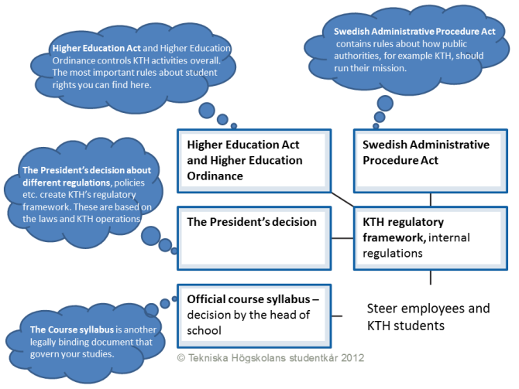
Opennes and equal opportunities: from legislation to policies and actions

Slide 29
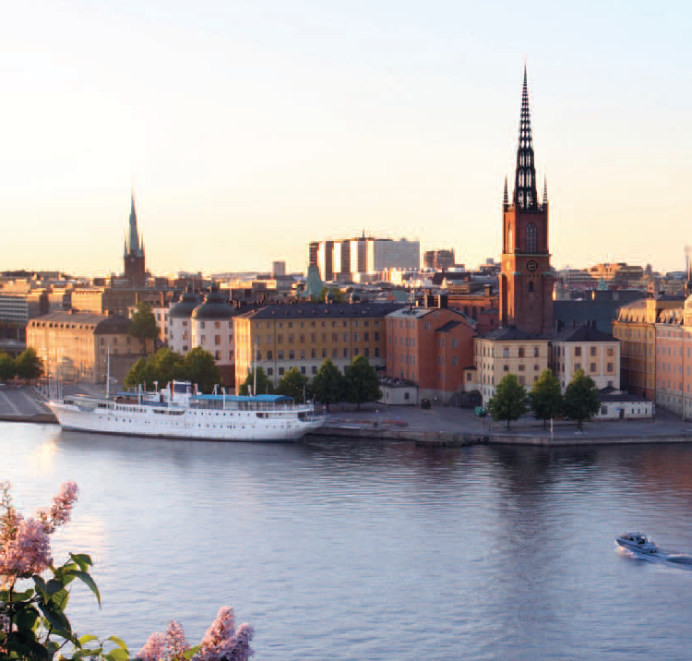
Stockholm – one of the most livable cities in the world
Nobel Prize Award Ceremony
One of the most livable cities
in the world acording to
Monocle
Tight relationship between
academia and business
UN Human Development
Index
Early adopters of new
technology and trends
Clean, tidy, safe
English speaking
Notes:
Innovation and entrepreneurship run deep in Swedish culture. From the Nobel Prize ceremonies to worldrenowned international business events, today’s leaders are drawn to the city on a regular basis. Whether it is technology, biomedicine, design or music, Stockholm is a highly progressive city with significant global influence. The city’s open, accessible atmosphere and tight relationships between academia and the business community are important contributors to this entrepreneurial spirit.
A wellspring of ideas
Living in Stockholm means having access to pioneering companies and business networks on a global scale. For KTH students and graduates, practical internships and job opportunities within a wide variety of industries are close at hand. The School of Information and Communication Technology, located at the KTH campus in Kista, is one of the world’s top ICT clusters. More than 500 ICT companies surround the campus, providing students a unique proximity to the industry.
ICT infrastructure giant Ericsson is headquartered there and IMB, Microsoft, Intel, and Oracle have all chosen Kista Science City for their Nordic headquarters.
A great place to live, learn and study
The un Human Development Index ranks the quality of life in Sweden amongst the highest in the world, and the lifestyle magazine Monocle recently named Stockholm as one of the world’s most liveable cities. With almost two million people in the metropolitan area, Stockholm
is a large city that retains its small-town atmosphere. Its inhabitants are well-educated early adopters of new trends and technologies, mobile phone subscriptions outnumber the people themselves, and Internet access is amongst the highest in the world.
From the KTH campus, almost everything in the city is within walking distance. The streets and public transport are clean, tidy and safe. Most students live close to campus and walk or ride a bike to class, and people in Stockholm generally speak excellent English, which makes the city very accessible to international visitors, companies, students and professors. From famous clubs and concert venues to international cuisine
and world-renowned museums, Stockholm provides all the major attractions a global city has to offer. For more information, visit www.stockholmtown.com

